Slide 1
Team 304 Project Presentation 1
Jose Aguilar, Ivan Makarenko, Kezmen Lozevski,Timothy Drafz,
Roshan Patel

Slide 2
Team organization
Team Charter:
Gain more insight on creating electronic systems utilizing industry level software such as Orcad Cadence, and MPlab.
Gaining more experience in the design and construction of different serial sensing and actuation circuits.
Demonstrating a neat project to friends and family.
Expanding our project resume with an interesting design that conveys what we learned throughout the course.
Gaining more confidence and familiarity with electrical systems in general to give us a higher repertoire of skills when handling future electrical system tasks.
Mission Statement:
To create a device that uses multiple unique sensors to take input from its environment and perform a meaningful or beneficial task.

Slide 3
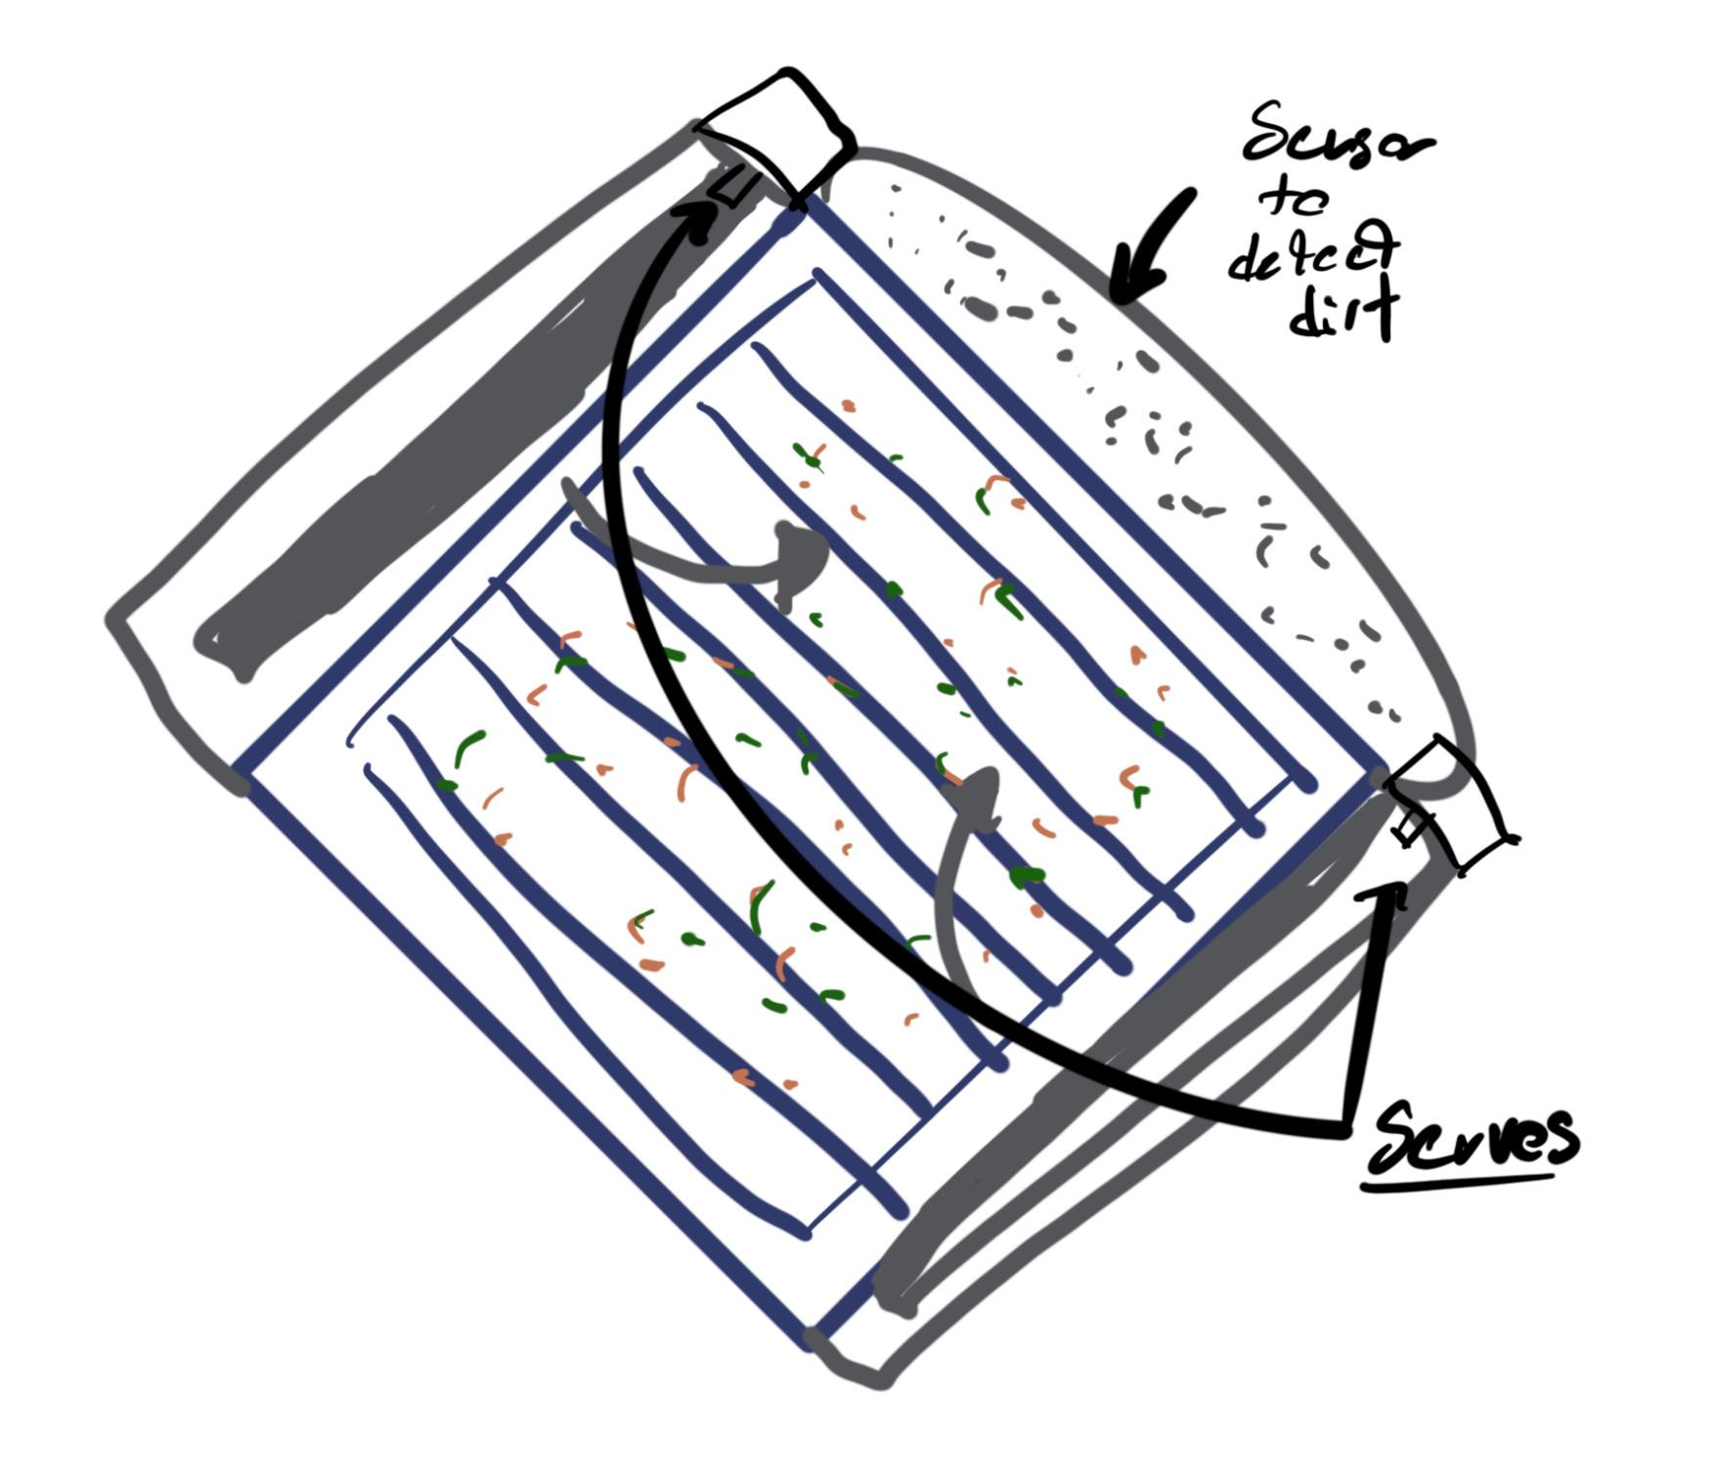
Design #1: Solar Panel Cleaner
Detects dirt and other particles on solar panel
Uses wiper blade like items to clean panel
Two servo motors operate the wiper blades

Slide 4
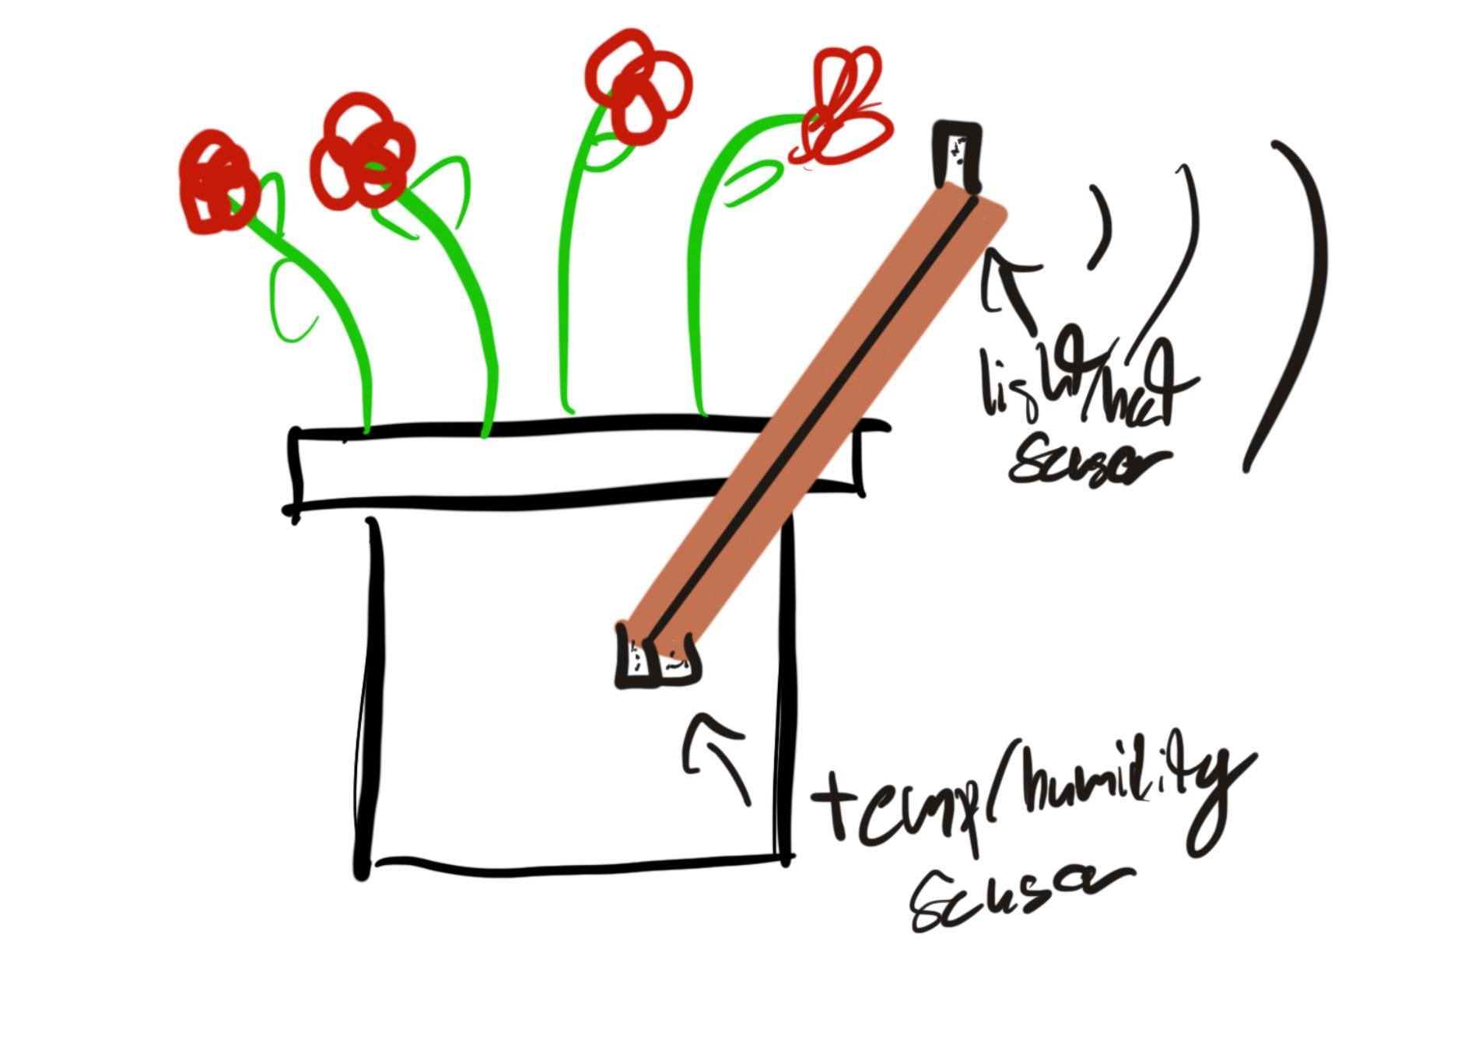
Design #2: Humidity/Light Flower Helper
Detects humidity and temp of dirt
Also detects sunlight and heat
Sends signal to owners phone let them know if the water levels are low or if its not getting enough sun

Slide 5
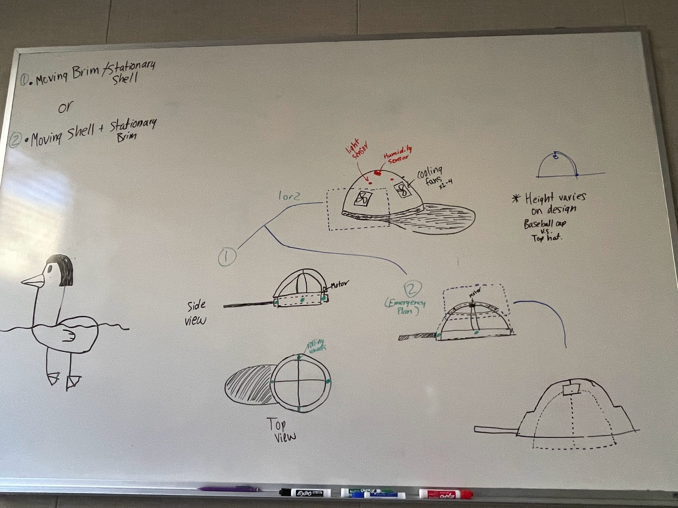
Design #3 Cool Hat
Detects Light in different directions
Built-in cooling fans
Humidity sensors included to activate fans when needed.
Light sensors determine where to move the hat brim to ensure shade in that direction

Slide 6
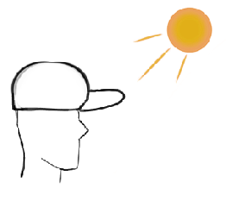
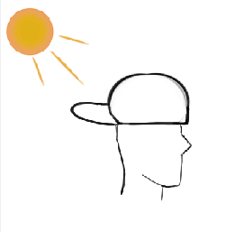
Hat sun tracking

Slide 7
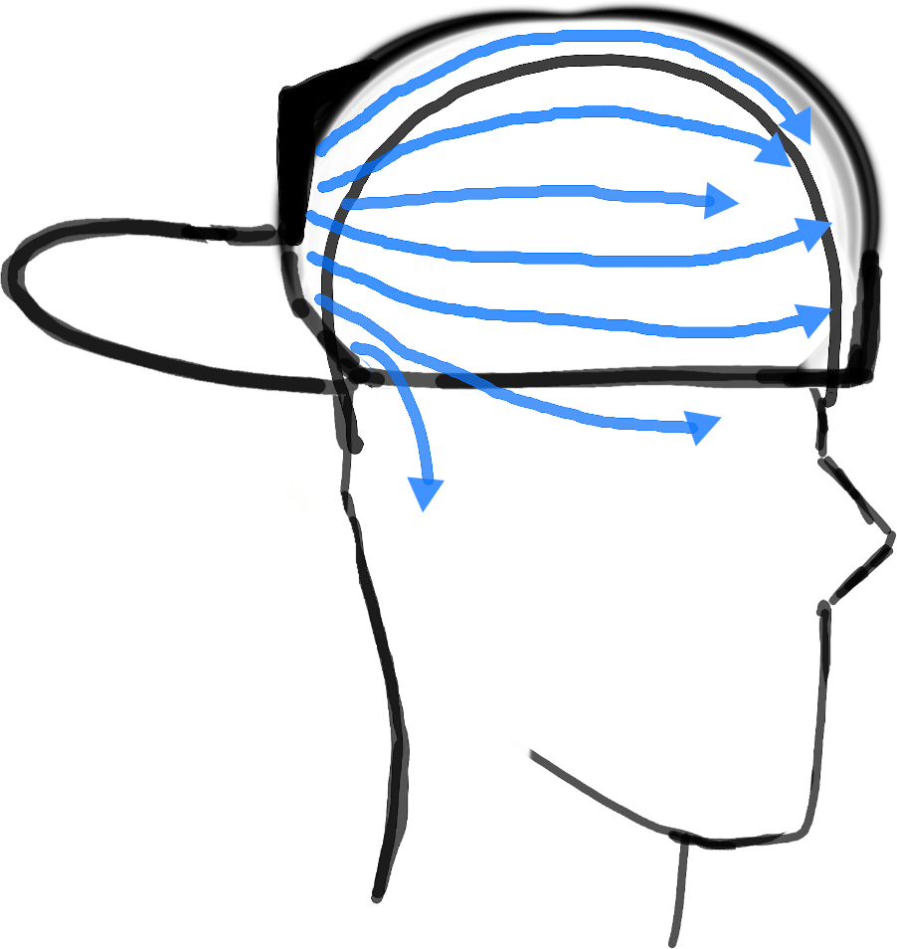
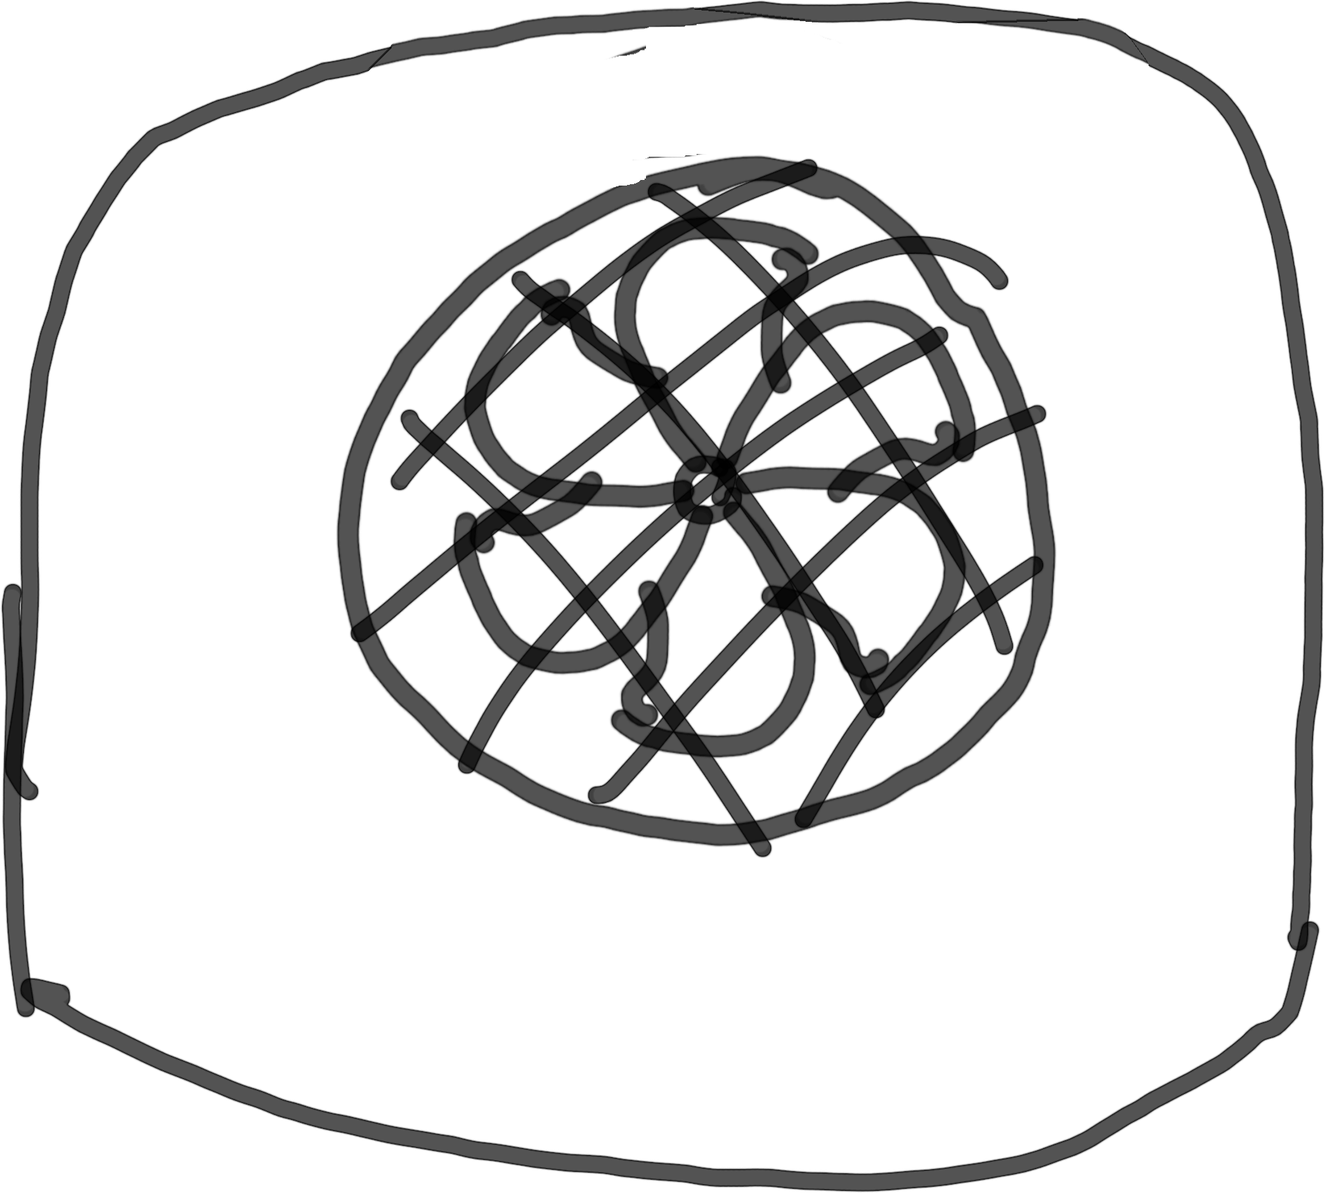
Hat convection cooling

Slide 8
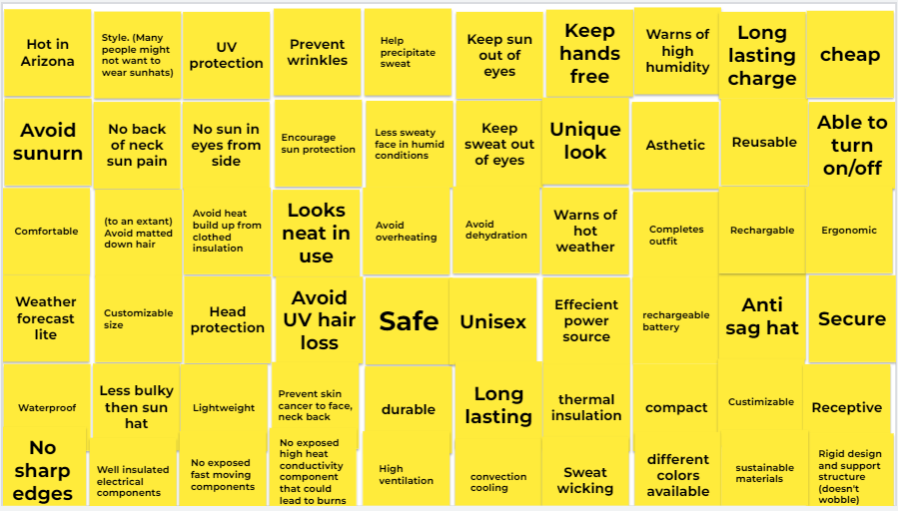
User needs

Slide 9
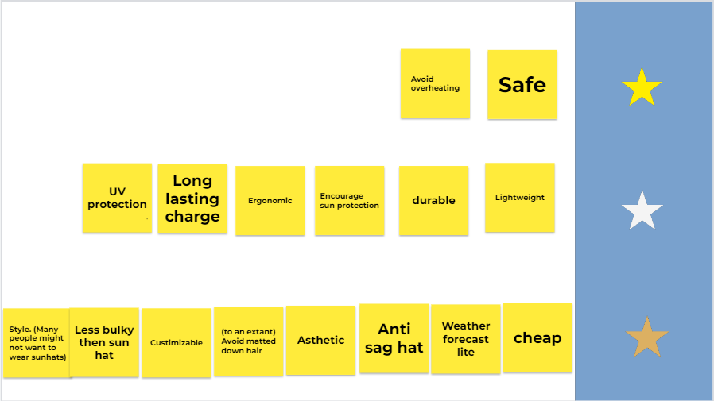
User needs (categorized)

Slide 10
